Slide 1
Basic Electronics
Basics of transistors

Slide 2
BJT Relationships - Equations
I_{E}
I_{C}
I_{E}
I_{C}
-
V_{CE}
+
+
V_{EC}
-
E
C
E
C
-
-
+
+
V_{BE}
I_{B}
V_{BC}
V_{EB}
V_{CB}
I_{B}
+
+
-
-
B
B
npn
I_{E} = I_{B} + I_{C}
V_{CE} = -V_{BC} + V_{BE}
pnp
I_{E} = I_{B} + I_{C}
V_{EC} = V_{EB} - V_{CB}
Note: The equations seen above are for the transistor, not the circuit.

Slide 3
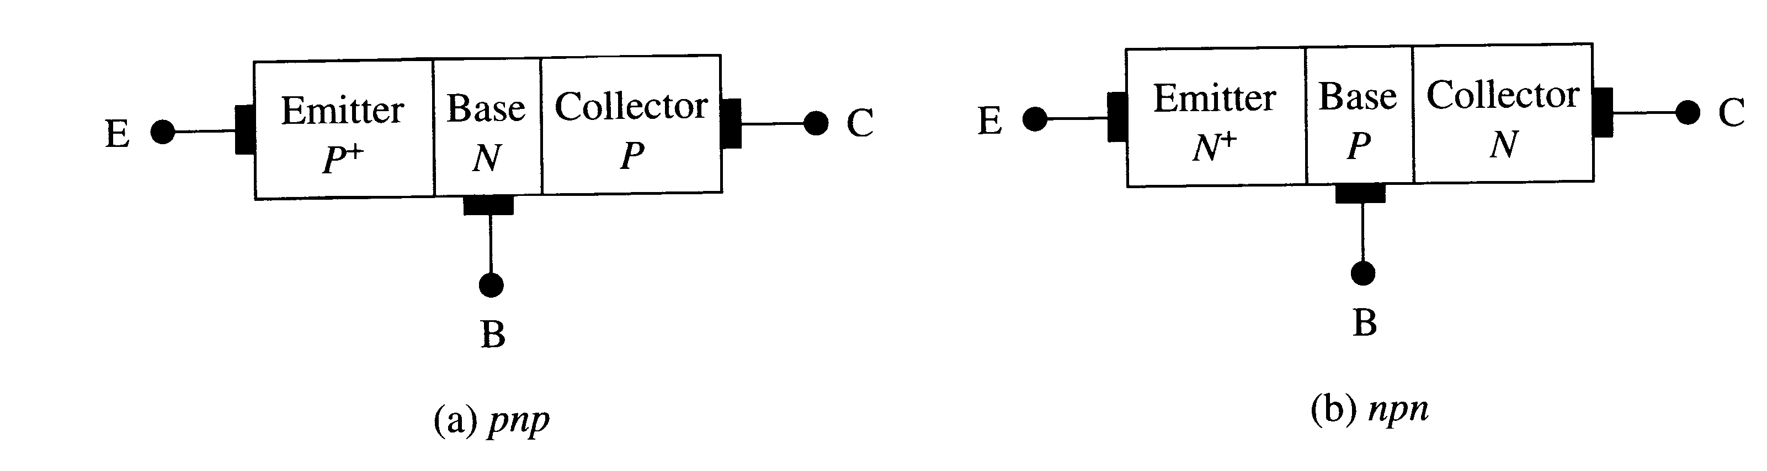
Bipolar Junction Transistors: Basics
Bias Mode | E-B Junction | C-B Junction
Saturation | Forward | Forward
Active | Forward | Reverse
Inverted | Reverse | Forward
Cutoff | Reverse | Reverse

Slide 4
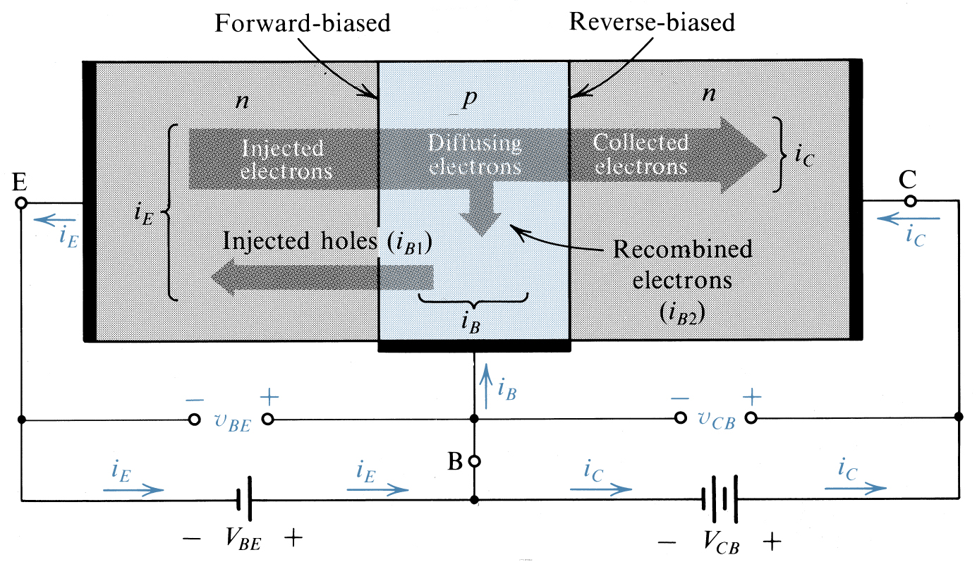
Operation of npn transistor
Large current

Slide 5
Modes of operation of a BJT transistor
Mode BE junction BC junction
cutoff reverse biased reverse biased
linear(active) forward biased reverse biased
saturation forward biased forward b

Slide 6
Operation of npn tra nsistor (active mode)
Large current

Slide 7
Summary of npn transistor behavior
npn
IC
collector
base
large current
IB
+
VBE
-
emitter
IE
small
current

Slide 8
Summary of pnp transistor behavior
pnp
IC
collector
base
large current
IB
+
VBE
-
emitter
IE
small
current

Slide 9
Summary of equations for a BJT
IE ≈ IC
IC = βIB
β is the current gain of the transistor ≈ 100
VBE = 0.7V(npn)
VBE = -0.7V(pnp)

Slide 10
4.5 Graphical representation of transistor characteristics
IC
IB
Output
circuit
Input
circuit
IE

Slide 11
Input characteristics
IB
IB
VBE
0.7V
Acts as a diode
VBE ≈0.7V

Slide 12
Output characteristics
IC
IC
IB = 40μA
IB = 30μA
IB = 20μA
IB = 10μA
VCE
Early voltage
Cutoff
region
At a fixed IB, IC is not dependent on VCE
Slope of output characteristics in linear region is near 0 (scale exaggerated)

Slide 13
Biasing a transistor
Transistor Biasing is the process of setting a transistors DC operating voltage or current conditions to the correct level so that any AC input signal can be amplified correctly by the transistor. A transistors steady state of operation depends a great deal on its base current, collector voltage, and collector current and therefore, if a transistor is to operate as a linear amplifier, it must be properly biased to have a suitable operating point .We must operate the transistor in the linear region.
A transistor’s operating point (Q-point) is defined by
IC, VCE, and IB.

Slide 14
Modes of Operation
Active:
Most important mode of operation
Central to amplifier operation
The region where current curves are practically flat
Saturation:
Barrier potential of the junctions cancel each other out causing a virtual short
Cutoff:
Current reduced to zero
Ideal transistor behaves like an open switch
* Note: There is also a mode of operation called inverse active, but it is rarely used.

Slide 15
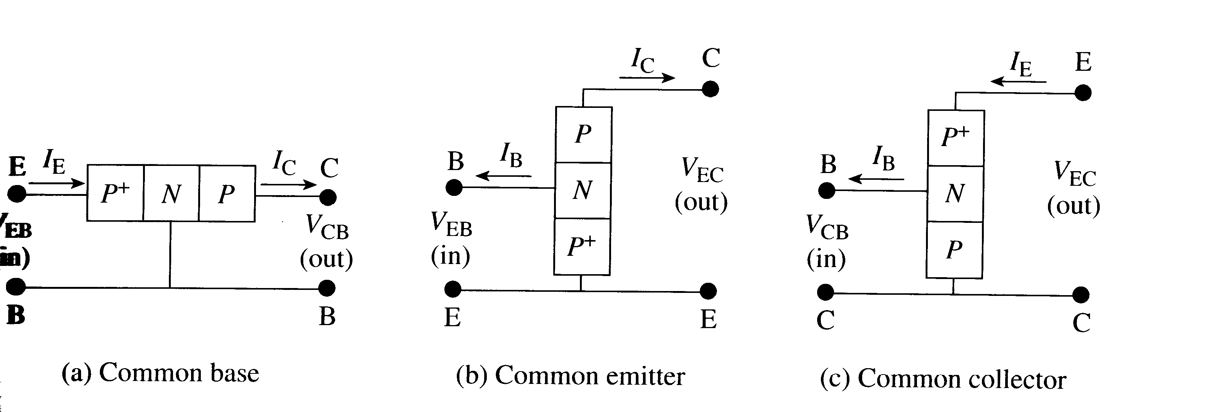
BJT configurations
GAIN
CONFIG

Slide 16
Three Types of BJT Biasing
Biasing the transistor refers to applying voltage to get the transistor to achieve certain operating conditions.
Common-Base Biasing (CB) : input = V_{EB} & I_{E}
output = V_{CB} & I_{C}
Common-Emitter Biasing (CE): input = V_{BE} & I_{B}
output = V_{CE} & I_{C}
Common-Collector Biasing (CC): input = V_{BC} & I_{B}
output = V_{EC} & I_{E}

Slide 17
Common-Base
Although the Common-Base configuration is not the most common biasing type, it is often helpful in the understanding of how the BJT works.
Emitter-Current Curves
I_{C}
Active Region
I_{E}
Saturation Region
Cutoff
I_{E} = 0
V_{CB}

Slide 18
Common-Emitter
Collector-Current Curves
I_{C}
Active Region
I_{B}
V_{CE}
Saturation Region
Cutoff Region
I_{B} = 0

Slide 19
Common-Collector
Emitter-Current Curves
The Common-Collector biasing circuit is basically equivalent to the common-emitter biased circuit except instead of looking at I_{C} as a function of V_{CE} and I_{B} we are looking at I_{E}.
Also, since α ~ 1, and α = I_{C}/I_{E} that means I_{C}~I_{E}
I_{E}
Active Region
I_{B}
V_{CE}
Saturation Region
Cutoff Region
I_{B} = 0

Slide 20
DC  and DC α
 = Common-emitter current gain
α = Common-base current gain
 = I_{C} α = I_{C}
I_{B} I_{E}
The relationships between the two parameters are:
α =   = α
 + 1 1 - α
Note: α and  are sometimes referred to as α_{dc} and _{dc} because the relationships being dealt with in the BJT are DC.

